Slide 1
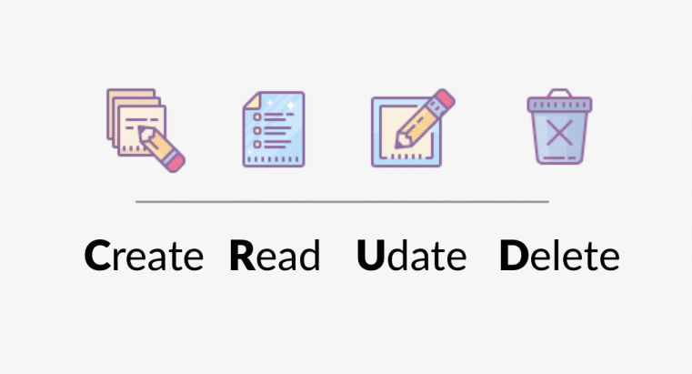
Mongo Database

Slide 2
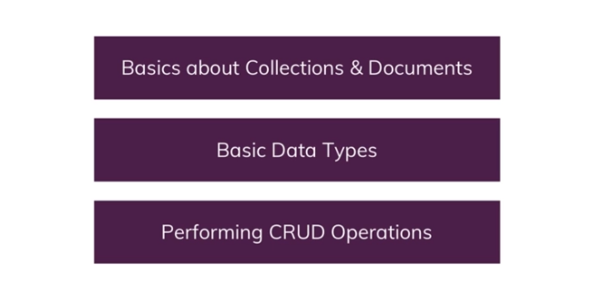
What we going to learn

Slide 3
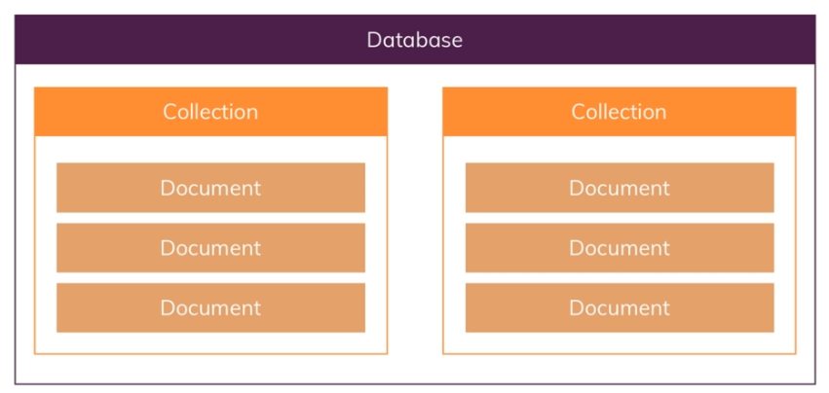
Database, Collections, Documents
Collections will be created once u start saving data

Slide 4
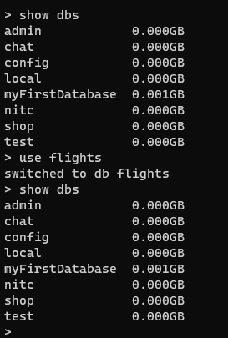
Create Databases & collections
List current databases
Create new DB with name flights
List current databases the new one not exist (flights)
The database flights will be created automatically when we start entering data.

Slide 5
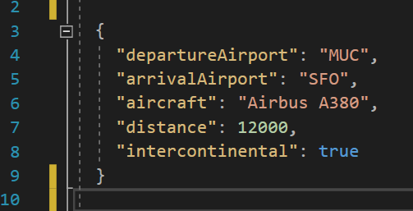
JSON !
Line 3: Json always start with {
Line 4,5,6: String
Line 7: Integer (Number)
Line 8: Boolean (true/false)
Line 9: Json always end with }

Slide 6
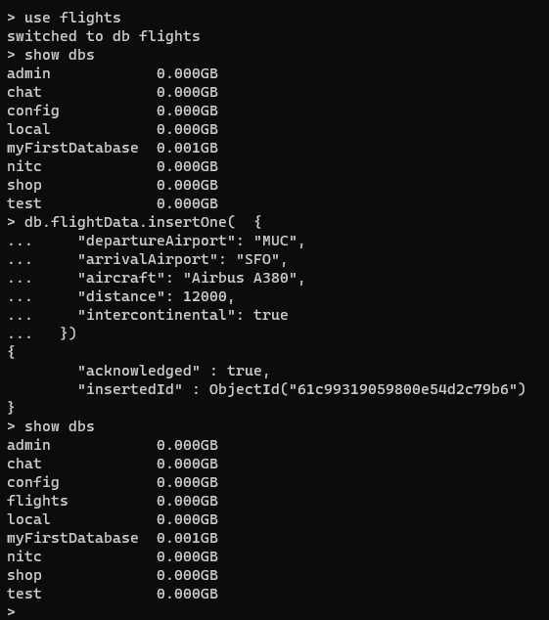
Create Databases & collections
Create new DB with name flights
List current databases the new one not exist (flights)
Insert One document, this command also will create new collection
With name flightData
List current databases flights exist
As u see we don’t give mongo id
For the documents Mongo
Will take care always to assign
A unique id using the ObjectId
To the document

Slide 7
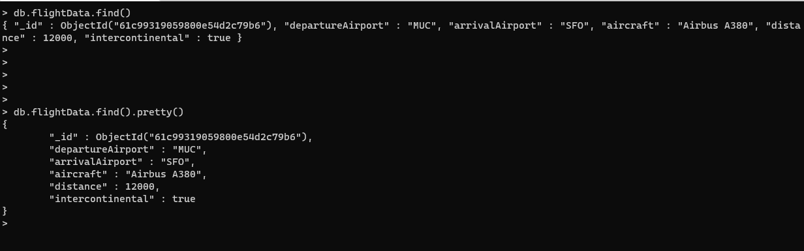
Return all the documents in the collection find()
find() → will return all the data in collection
find().pretty() → will return all the data in collection and show them in pretty way

Slide 8
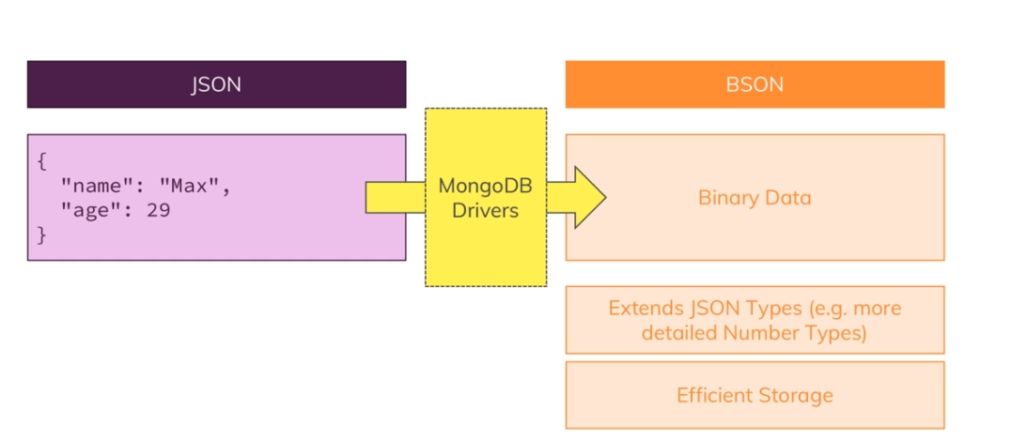
JSON vs BSON
MongoDB at the end saving data in BSON format binary data.
Mongo drivers take care for the conversion between json and Bson data
Its more efficiency to store Bson data over Json data, faster and from space perspective.

Slide 9
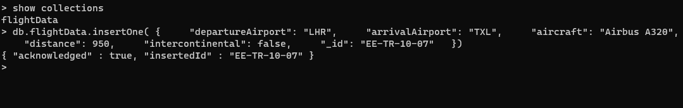
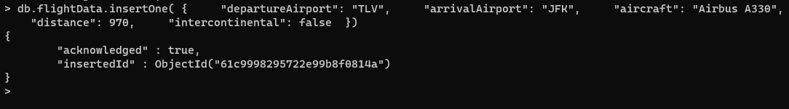
Insert document and assign id
In the example below we assign id to the document its not recommended
In the example below we don’t assign id to the document and let Mongo generate one for us

Slide 10
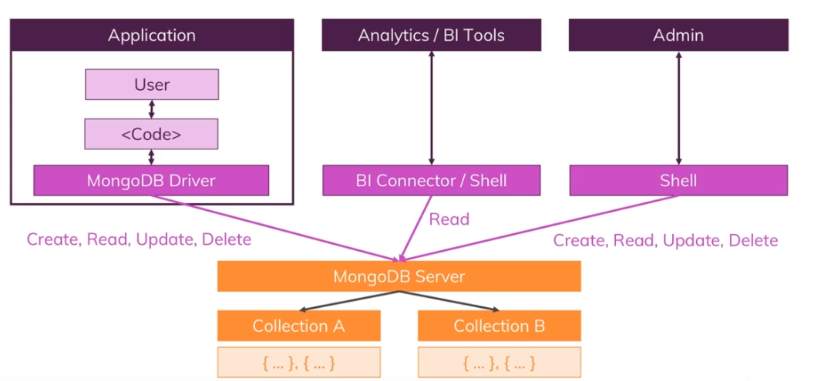
CRUD Operation In Real World System
Let assume that we have Application and another system for analytics and Admin application all of them will interact with
The Mongo Server and Create Update also Delete data.

Slide 11
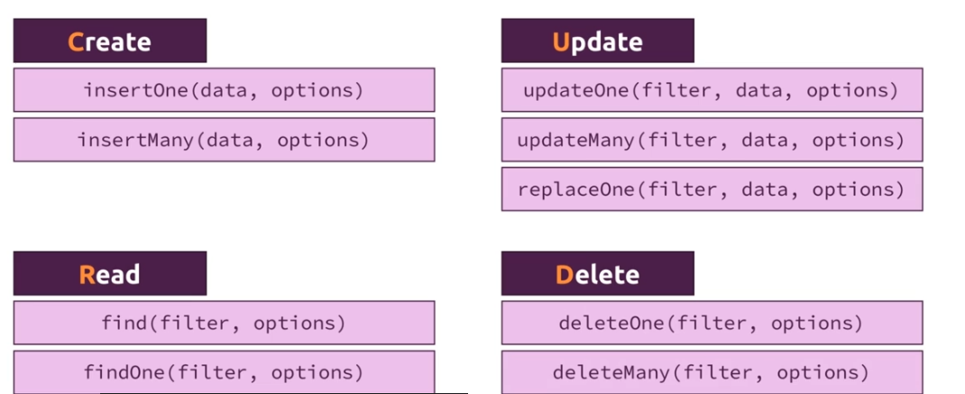
CRUD Operation In Real World System

Slide 12
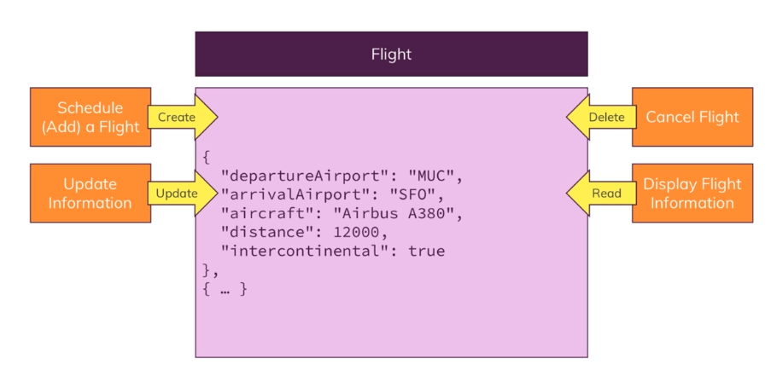
Flight Data Example

Slide 13
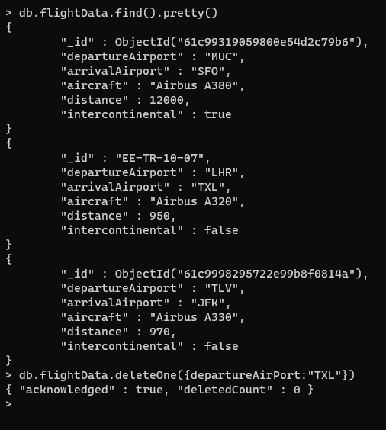
Delete Data Example
deleteOne take a filter to find out which document to delete.
A filter defined as document so with curly braces and then define which key and which value
Delete document with departureAirport equal to TXL. We can use any json attribute such like _id, distance, … and it will
Delete the first document with the filter.
Read more

Slide 14
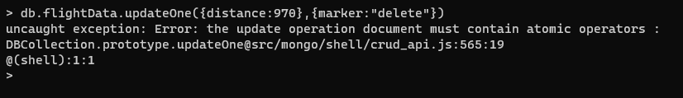
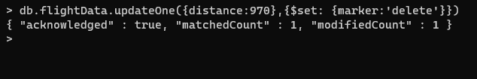
UpdateOne Data Example
Please set the value of attribute marker with delete.
What will happen if the attribute is not exist it will add it to the Document, and if it exist will update it with the value delete.
$set → its saved value in Mongodb
First argument filter. Second argument the new values update or add new values
Read more

Slide 15
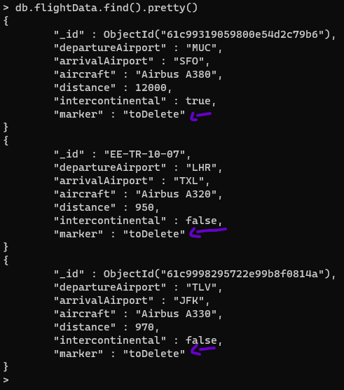
UpdateMany Data Example
In updateMany we update all the document with
New attribute marker.
The empty filter {} in Mongo will select all documents
As u can see all document have the attribute marker with value toDelete
Read more

Slide 16

DeleteMany Data Example
Delete many with filter that we added before.
Show collection documents is empty.
Read more

Slide 17
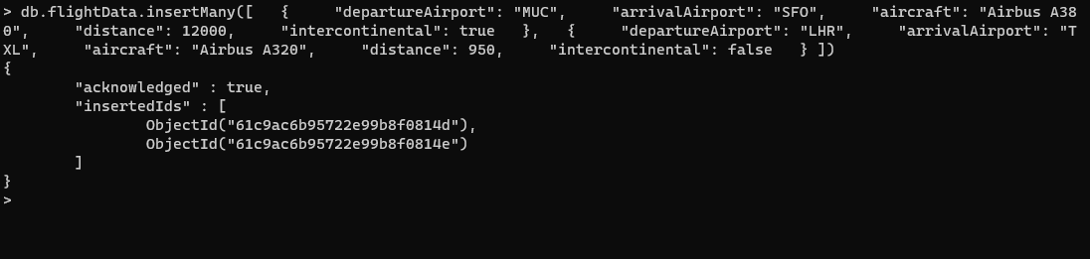
InsertMany Data Example
insertMany will insert more then one document at once. It accept array of objects separated by ,

Slide 18
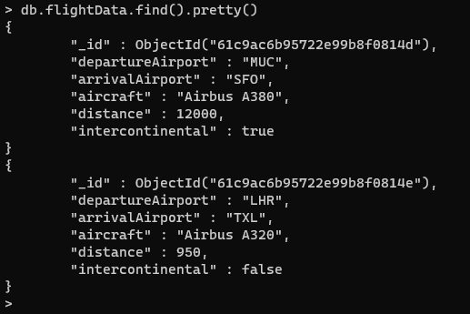
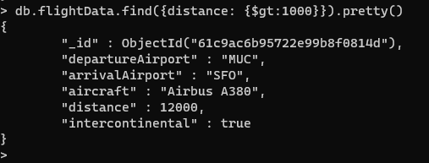
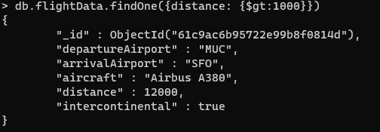
Find() - operation $gt
As u can see the returned value distance greater then 1000
find() will return all the matching documents
findOne() will return the first matching document

Slide 19
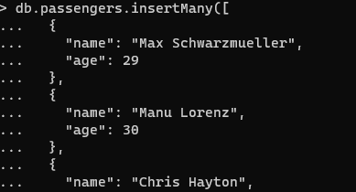
Insert all the data into new collection passengers
Take the data from passengers.json file

Slide 20
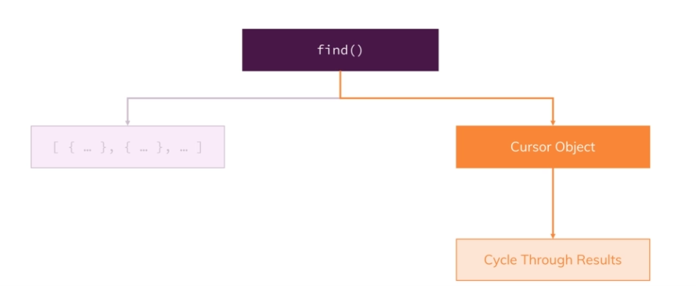
find() and it
find() return a cursor, and not all the data!
It gives us a cursor object, and it make a lot of scenes because that collection could be very big.
If we think about collection with 44 million documents, then this would take super long but most importantly
It would send a lot of data. So instead of that, it gives us back cursor object which is an object with a lot of metadata
behind it that allows us to cycle through the results, and that what the it command did.
toArray() → will send us all the data

Slide 21
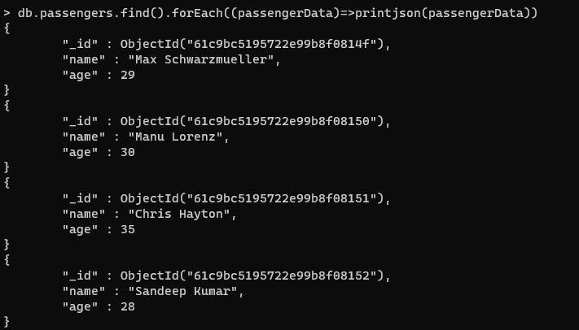
find() and foreach
Find jives us a cursor and then it’s up to u to use
That cursor with toArray to force it. Or
foreach and there is more method check mongo docs

